Slide 1
STRINGS and STRING METHODS

Slide 2
STRINGS
In Java, String represents a sequence of characters and is implemented as an object in the java.lang package, implicitly available in all Java programs
Strings are immutable: once created, their contents can’t change. Any operation that modifies a string actually returns a new String object
String Literals
When you write "Hello", Java checks the string pool. If an identical literal exists, it reuses it; otherwise, a new one is created—making literals memory-efficient
Using new String(...)
This always creates a fresh string object on the heap, even if an identical literal is already in the pool

Slide 3
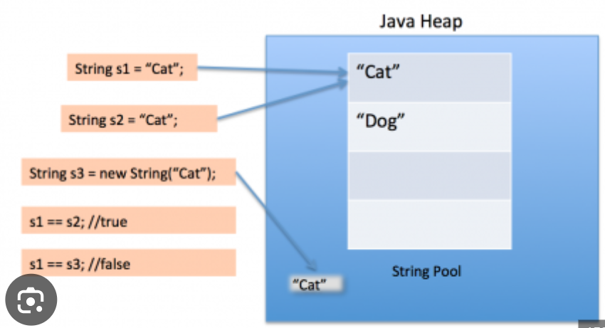
String pool
Heap Memory: The main area where Java objects reside.
String Pool (within Heap): A special region within the heap dedicated to storing unique string literal objects.

Slide 4
String s1 = "hello"; // stored in pool
String s2 = "hello"; // stored in pool
String s3 = new String("hello"); // stored in the heap memory
System.out.println(s1 == s2); // true — same pooled literal
System.out.println(s1 == s3); // false — different object
System.out.println(s1.equals(s3)); // true — same content

Slide 5
STRING METHODS
1. String Length
length() → Returns the length of the string.
String str = “JAVA PROGRAM";
System.out.println(str.length());
// Output: 11
2. String Concatenation
concat(str) → Concatenates two strings.
String str1 = "Hello";
String str2 = "World";
System.out.println(str1.concat(" " + str2)); // Output: Hello World

Slide 6
3. Case Conversion
toUpperCase() → Converts the string to uppercase.
toLowerCase() → Converts the string to lowercase.
String str = "Java";
System.out.println(str.toUpperCase()); // Output: JAVA System.out.println(str.toLowerCase()); // Output: java
4. Checking Character Types
isUpperCase() / isLowerCase() → Checks if characters are
uppercase/lowercase.
char ch = 'A';
System.out.println(Character.isUpperCase(ch)); // Output: true
System.out.println(Character.isLowerCase(ch)); // Output: false

Slide 7
5. Character Extraction
charAt(index) → Returns the character at the specified index.
String str = "Java";
System.out.println(str.charAt(1)); // Output: a
6.Checking if String is Empty or Blank
isEmpty() → Returns true if the string is empty ("").
IsBlank() → Returns true if the string is empty or contains only white
spaces.
String str1 = "";
String str2 = " ";
System.out.println(str1.isEmpty()); // Output: true
System.out.println(str2.isBlank()); // Output: true

Slide 8
7. Substring Extraction
substring(startIndex) → Extracts substring from the given index to the
end.
substring(startIndex, endIndex) → Extracts substring between given
indexes.
String str = "Hello World";
System.out.println(str.substring(6)); // Output: World
System.out.println(str.substring(0, 5)); // Output: Hello

Slide 9
8. String Comparison
equals(str) → Checks if two strings are equal.
equalsIgnoreCase(str) → Checks equality ignoring case.
compareTo(str) → Compares two strings lexicographically.
String str1 = "Java";
String str2 = "java";
System.out.println(str1.equals(str2)); // Output: false
System.out.println(str1.equalsIgnoreCase(str2)); // Output: true
System.out.println(str1.compareTo("Javb")); // Output: -1
How it Works:
string1.compareTo(string2) returns:
0 if both strings are equal
A positive value if string1 is greater than string2
A negative value if string1 is less than string2

Slide 10
9. String Search
indexOf(char/substring) → Returns the index of the first occurrence.
lastIndexOf(char/substring) → Returns the last occurrence index.
contains(str) → Checks if string contains a substring.
startsWith(str) → Checks if string starts with a given substring.
endsWith(str) → Checks if string ends with a given substring.
String str = "Hello World";
System.out.println(str.indexOf('o')); // Output: 4
System.out.println(str.lastIndexOf('o')); // Output: 7
System.out.println(str.contains("World")); // Output: true
System.out.println(str.startsWith("Hello")); // Output: true
System.out.println(str.endsWith("World")); // Output: true

Slide 11
10.String Modification
replace(oldChar, newChar) → Replaces all occurrences of a character.
replaceAll(regex, replacement) → Replaces all substrings matching a
regex.
trim() → Removes leading and trailing spaces.
String str = " Java Programming ";
System.out.println(str.trim()); // Output: "Java Programming"
System.out.println(str.replace('a', '@')); // Output: J@v@ Progr@mming
System.out.println(str.replaceAll("[aA]", "#"));
System.out.println("123abc".replaceAll("[0-9]", "*")); // Output: ***abc

Slide 12
11. Splitting and Joining
split(delimiter) → Splits string into an array based on a delimiter.
join(delimiter, elements…) → Joins multiple elements into a single
string.
String str = "apple,banana,grape";
String[] fruits = str.split(",");
for (String fruit : fruits) {
System.out.println(fruit);
}
// Output: apple
// banana
// grape
String joined = String.join(" - ", "Java", "Python", "C++");
System.out.println(joined); // Output: Java - Python - C++

Slide 13
12. String Conversion
valueOf(data) → Converts different data types to a string.
int num = 100;
String str = String.valueOf(num);
System.out.println(str + 10); // Output: 10010

Slide 14
13. Interning a String
intern() → Returns the canonical representation of the string from the
string pool.
String str1 = new String("Java");
String str2 = str1.intern();
System.out.println(str1 == str2); // Output: false
System.out.println(str2 == "Java"); // Output: true

Slide 15
14. Checking String Content
matches(regex) → Checks if string matches a regular expression.
String str = "Java123";
System.out.println(str.matches("[A-Za-z0-9]+")); // Output: true
System.out.println(str.matches("\\d+")); // Output: false
15 Removing Characters
replaceFirst(regex, replacement) → Replaces the first occurrence
matching the regex.
String str = "Java is fun, Java is powerful";
System.out.println(str.replaceFirst("Java", "Python"));
// Output: Python is fun, Java is powerful

Slide 16
16. Getting Bytes and Characters
getBytes() → Converts string into a byte array.
toCharArray() → Converts string into a character array.
String str = "Hello";
byte[] byteArray = str.getBytes();
char[] charArray = str.toCharArray();
System.out.println(Arrays.toString(byteArray)); // Output: [72, 101, 108, 108,
111]
System.out.println(Arrays.toString(charArray)); // Output: [H, e, l, l, o]

Slide 17
17. Formatting a String
format(format, args…) → Returns a formatted string.
String name = "aaa";
int age = 25;
String formatted = String.format("Name: %s, Age: %d", name, age);
System.out.println(formatted);
// Output: Name: aaa, Age: 25
18. String Joining with Multiple Values
join() → Joins multiple strings with a delimiter.
String result = String.join("-", "Java", "Python", "C++");
System.out.println(result); // Output: Java-Python-C++

Slide 18
19. Converting String to Numeric Values
Integer.parseInt(str) → Converts a string to an integer.
Double.parseDouble(str) → Converts a string to a double.
String str = "100";
int num = Integer.parseInt(str);
double dnum = Double.parseDouble("99.99");
System.out.println(num + 1); // Output: 101
System.out.println(dnum + 0.01); // Output: 100.0

Slide 19
20. Using regionMatches()
regionMatches(start1, str2, start2, length) → Compares a region of
two strings.
String str1 = "JavaProgramming";
String str2 = "Programming";
System.out.println(str1.regionMatches(4, str2, 0, 11)); // Output: true
21. Escaping Special Characters
Use escape sequences in strings:
String str = "She said, \"Java is awesome!\"";
System.out.println(str); // Output: She said, "Java is awesome!"

Slide 20
22. Checking a String's Code Points
codePointAt(index) → Returns the Unicode value at the given index.
codePointBefore(index) → Returns the Unicode value before the given
index.
codePointCount(beginIndex, endIndex) → Returns the count of
Unicode points in a substring.
String str = "Hello";
System.out.println(str.codePointAt(0)); // Output: 72 ('H')
System.out.println(str.codePointBefore(1)); // Output: 72 ('H')
System.out.println(str.codePointCount(0, 5)); // Output: 5

Slide 21
23. Checking Whether a String is Numeric
Use matches() to check if a string is numeric.
String str = "12345";
System.out.println(str.matches("\\d+")); // Output: true

